Slide 1
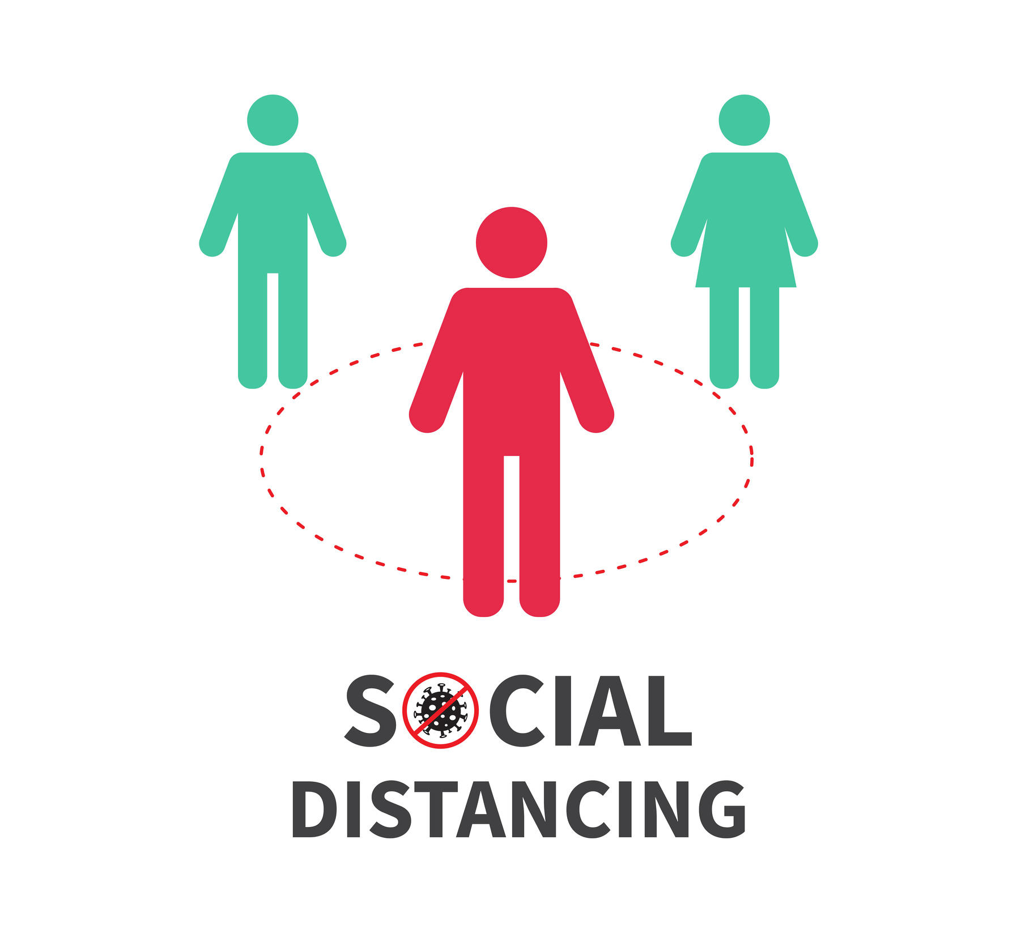
Social Distance Monitoring
in Covid19 Situation
Group 08
1706145,149,150,153,189

Slide 2
Project Overview:
Problem: Human localization from image and determine distance and assuring safe distance
We have used deep learning approach to do this project
Used Pretrained networks and transfer learning method
Detect humans from image , localize them and measure distance between them.
If they are very close, we will be given an alert
Thus, we can assure the social distancing in covid19 situation, or any other pandemic in future

Slide 3
Workflow
Check various method for this problem’s solution
Collect and created Dataset of images
Labelling the images
Using pretrained network and Yolov2 subnetwork in MATLAB
Training by different networks and training options
Select best performing model
Determining distance from detected people
Determining accuracy

Slide 4
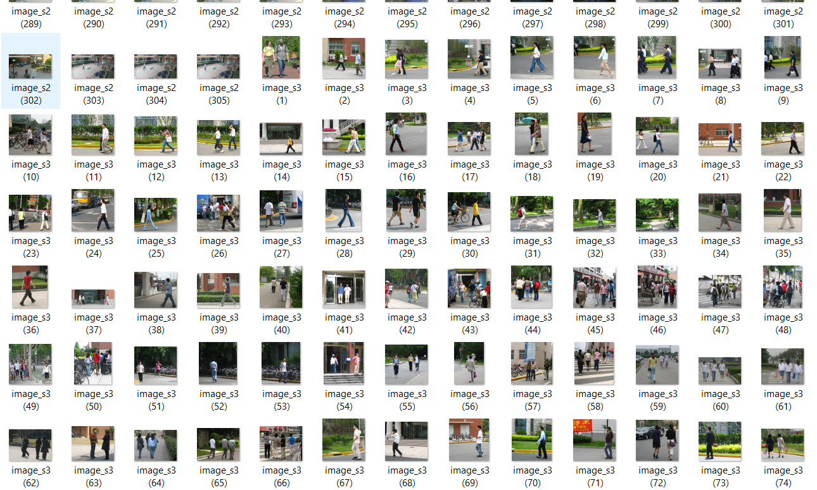
Datasets Collection
We have collected some image from pedestrian video.
And also downloaded datasets from internet
There was total 814 images for our project.

Slide 5
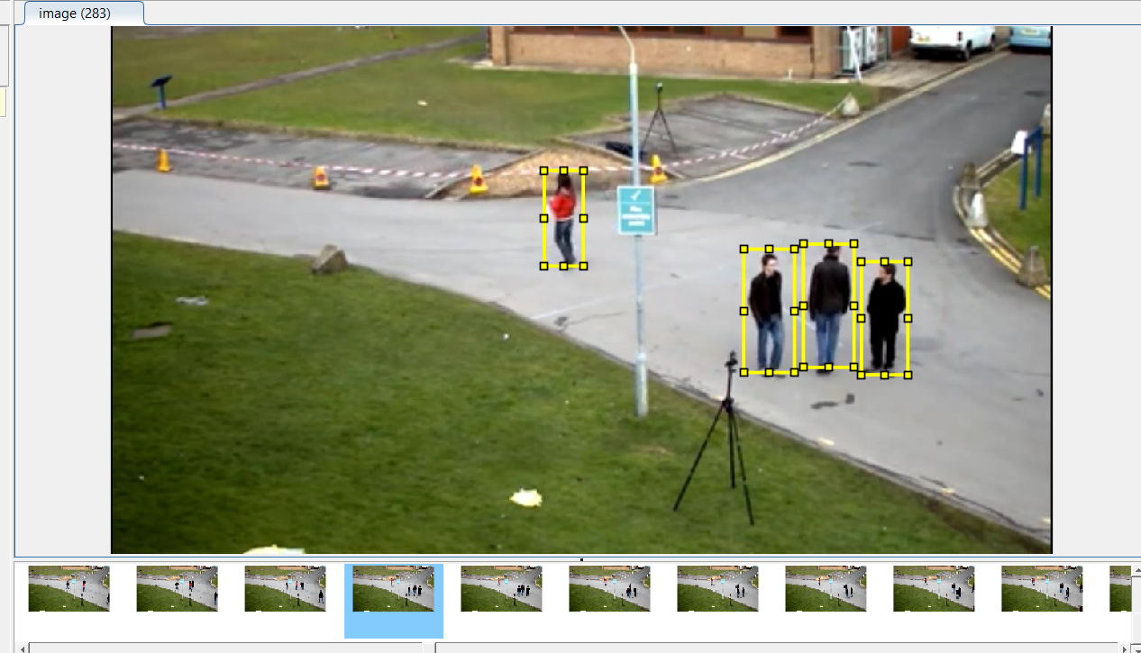
Dataset Labeling
We have used Image labeler app of MATLAB to label our images
There was only single class , named “human”
After labeling , this labelled images were used as ground truth data for the model

Slide 6
Convolutional neural Network Architecture
Input layer
(256x256x3)
Base network is Darknet-53
Image Input size = 256x256x3
Feature extraction layer “res14”
Num_Class=1;
Num_anchorbox=1;
14 residual block in base network.
There is many number of convolution, batch normalization, and leaky relu layers
Feature extraction is happening in the base network portion
A part of full Darknet53 network
114 layers
(dim: 16x16x512)
Total 123 Layers
Yolov2 subnetwork
8 layers
(dim: 16x16x6)
Yolov2 Output Layer

Slide 7
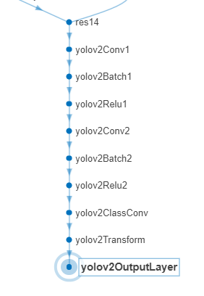
Yolov2 Subnetwork
In yolov2 subnetwork, there is only conv. and relu layer, last two layers are yolov2 transform layer and yolov2outputlayer
The features are taken from “res14” layer of darknet53, and feeds to yolov2 layers
In the subnetwork portion, yolov2 localize the object, predict with bounding box .
Finally we got an image with detected people with bounding boxes co- ordinate, obviously after training.
Yolov2 subnetwork
Creating yolov2 layers

Slide 8
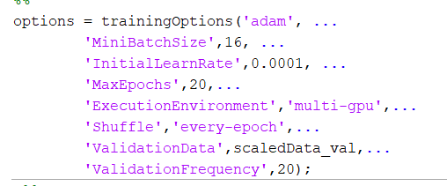
Training the whole network
1st stage training
Training data: 730 images
Validation data: 50 images
Test data: 24 images
Optimizer: ‘ADAM’
Mini batch size = 16 images
Total epochs =20;
At first stage training, training loss was 0.3
And validation loss was 0.5 ~ 0.6.
Training options
Training command

Slide 9
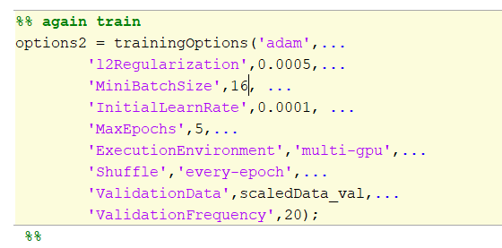
Training the whole network
For more improvement, we have trained the detector again .
2nd stage training
Optimizer: ‘ADAM’
Mini batch size = 16 images
Total epochs =5;
In this case loss was decreased slightly
Finally , we got our detector.
Which can be directly used for detect human in an image or video
Training options
2nd stage training command

Slide 10
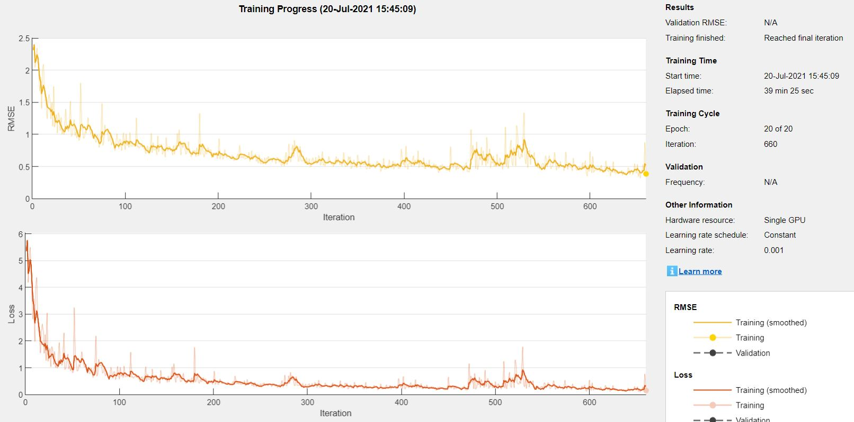
Training Curve

Slide 11
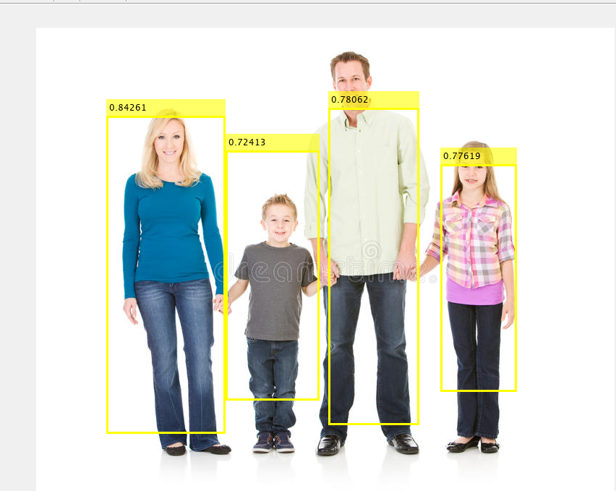
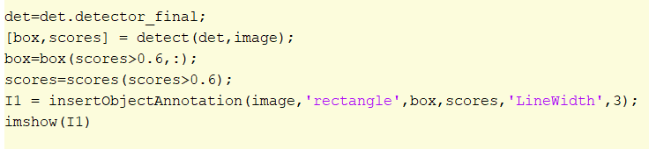
Detection
The detector is able to detect persons from images
Both man, woman, children also.
Command for detection

Slide 12
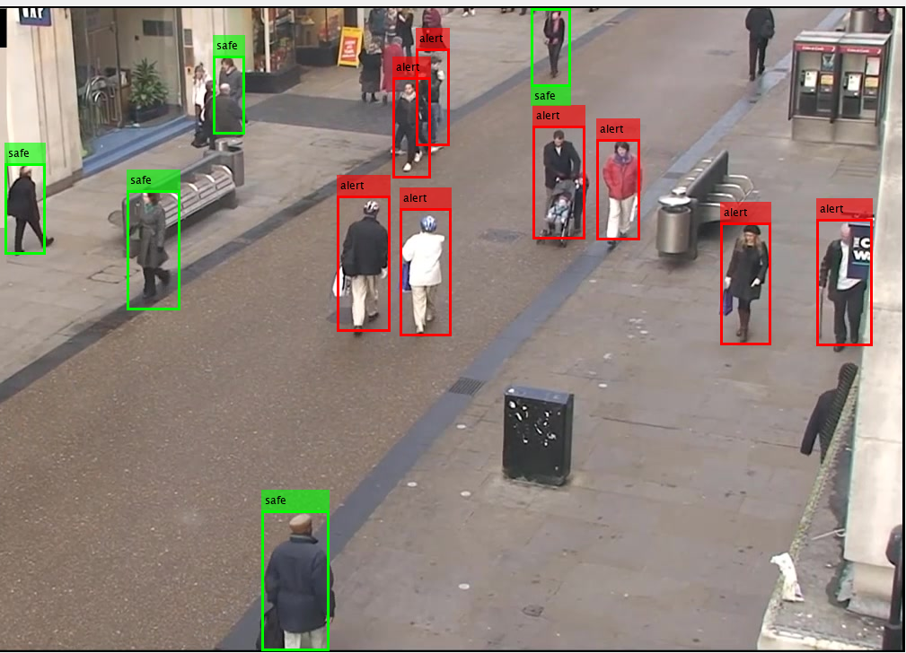
Determining the distance and marking as people safe or alert
Firstly detects all humans from image, with bounding box coordinate,
Then , determines the center of all bounding box
Next, determine the distance between all centers
If any distance crossed the threshold distance, the bounding box will be shown in red color, which means “alert signal”
Otherwise, the bounding box will be shown as green color
We can calibrate the threshold distance

